Slide 1
International experiences with DRG system and options for Georgia
Seminar for piloting hospitals
Triin Habicht
WHO consultant
11 September, 2018

Slide 2
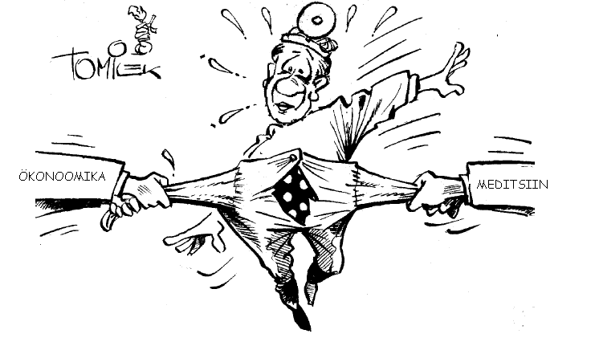
Finances
Finances
Medicine
Medicine

Slide 3
Challenges of Health System Management
Production Efficiency
Quality Management
Cost Management
Strategic Planning

Slide 4

“How could industrial methods of cost and quality control be adapted and applied to the hospital industry?”
“What is the true product of the hospital?”
Fetter and Thomson, Yale University (1968)
Notes:
Asked by researchers a the Yale School of Health to researchers at the Yale School of Administrative Sciences.

Slide 5
One DRG= One product= One cost

Slide 6
What DRG is?
DRG – diagnosis related groups
DRGs is a tool to relate the types of patients a hospital treats to the costs incurred or resources expended by placing patients in similar groups based on their diagnosis and procedures

Slide 7
Building blocks of DRG systems
Data collection
2
  Demographic data
  Clinical data
  Cost data
  Sample size, regularity
Price setting
3
Actual reimbursement
4
Patient
classification
system
  Volume limits
  Outliers
  High cost cases
  Quality
  Innovations
  Negotiations
1
  Cost weights
  Base rate(s)
  Prices/ tariffs
  Average vs “best”
  Diagnoses
  Procedures
  Severity
  Frequency of revisions
Source: Adapted from Busse, EURO-DRG project, 2012

Slide 8
Key principles to shape a classification system (Fetter 1991)
Patient
classification
system
1
  Diagnoses
  Procedures
  Severity
  Frequency of revisions
The definition of groups is to be based on information routinely collected in computerized hospital abstracts
There is to be a “manageable” number of groups
Each group is to contain cases with similar patterns of resource use (“resource homogeneous”)
Each group is to contain cases that are similar from a clinical perspective (“clinically meaningful”)

Slide 9

Grouping principles of Diagnosis Related Groups
A method to define the “products” of the hospital
Computed from routinely available data
Age
Sex
Principle diagnosis, complications & co-morbidities: ICD-10
Procedures: NCSP
Discharge status [e.g. transfer, home, death]
Weight on admission [newborns & neo-nates]
Other [e.g. length of stay]

Slide 10
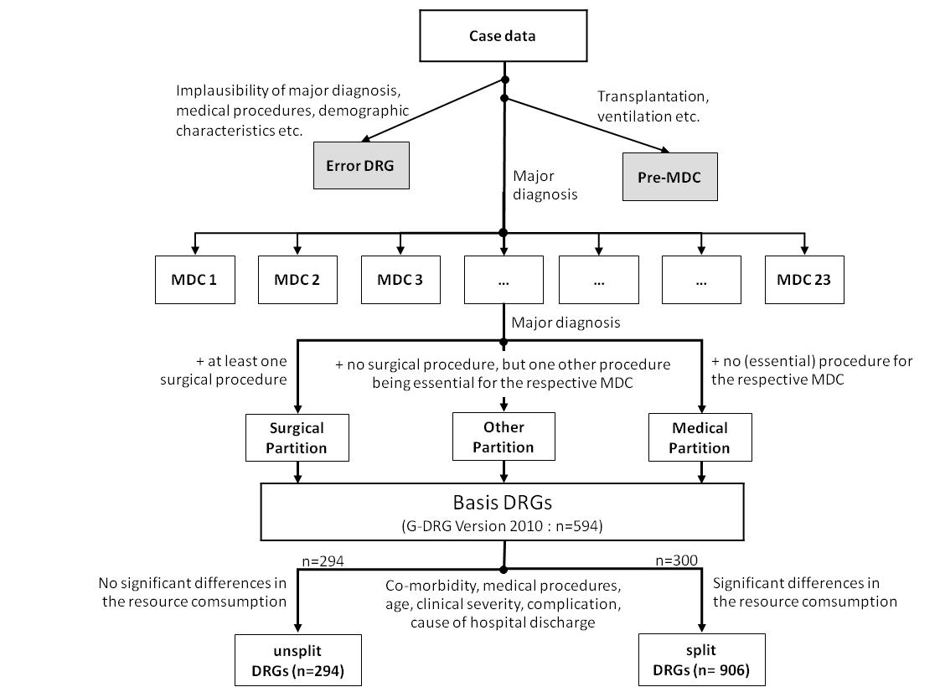
German DRG example

Slide 11
Patient Grouping Methodologies
In the last 30+ years, groupers have been developed using two main approaches: clinical input and statistical analyses
  Only clinical or only statistical grouping principles are not enough
Grouping methodologies:
  must limit data elements to routinely collected data
  generate a manageable number of possible categories
  demonstrate some degree of clinical coherence, and
  demonstrate statistical homogeneity with respect to either length of stay (LOS) or total resource use

Slide 12
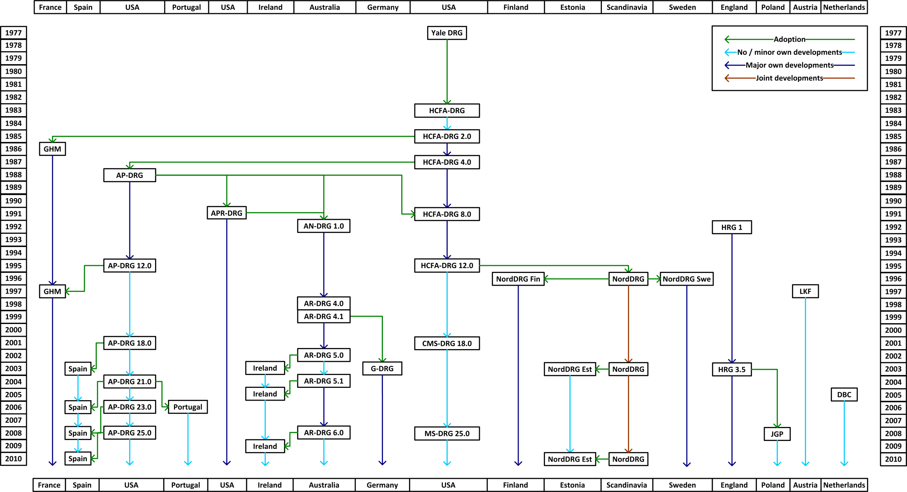
Different patient classification system
Patient
classification
system
1
  Diagnoses
  Procedures
  Severity
  Frequency of revisions
Find more: http://perspectives.ahima.org/disease-groupings-what-are-they/

Slide 13






6 versions of Thai DRG
2018
2012
2007
2003
1,543
2001
2,450
1999
1,920
1,283
511
511

Slide 14
Data collection
2
Complete Documentation
⬇
Correct Medical Coding
⬇
Correct DRG
⬇
Appropriate Reimbursement
  Demographic data
  Clinical data
  Cost data
  Sample size, regularity

Slide 15
TOP10 DRGs in Georgia
EST_DRG |  | EST_DRG_name | # of cases | % of total
127 |  | Heart failure & shock | 6 968 | 6 %
470 |  | Ungorupable | 5 369 | 5 %
373 |  | Vaginal delivery w/o complicating diagnoses | 5 019 | 5 %
039Q |  | Unilateral lens procedures with or without vitrectomy, short therapy | 4 155 | 4 %
070B |  | Otitis media & uri, age 0-17, w/o cc | 3 834 | 4 %
140 |  | Angina pectoris | 3 828 | 4 %
371 |  | Cesarean section w/o cc | 3 736 | 3 %
87 |  | Pulmonary edema & respiratory failure | 3 427 | 3 %
90 |  | Simple pneumonia & pleurisy, age > 17 w/o cc | 3 361 | 3 %
60 |  | Operations on tonsils or adenois, short therapy | 2 805 | 3 %
Other DRGs |  |  | 66 276 | 61 %
Total |  |  | 108 778 | 100 %

Slide 16
Data requirements to define case groups and tariffs
Data collection
2
  Demographic data
  Clinical data
  Cost data
  Sample size, regularity
High quality clinical data on diagnoses and (surgical) procedures
Cost data to define relative weights of DRG groups and to set a base rate
    Option to import cost data but difficult to contextualize
    Good cost data requires standardized cost accounting – easier to define a sample of hospitals
    Decision what costs (recurrent/capital) costs are included
Cost does not have to be equal to the tariff/price
    Actual vs best practice
    Price incentives
Price setting
3
  Cost weights
  Base rate(s)
  Prices/ tariffs
  Average vs “best”

Slide 17
DRG payment rate calculation
Price setting
3
  Cost weights
  Base rate(s)
  Prices/ tariffs
  Average vs “best”
Payment rate for particular DRG-group
=
Cost weight
+
Base rate
+
Adjustment factor

Slide 18
DRG cost weights
A DRG cost weight measures the expected cost of a certain DRG, relative to the expected cost of the average case across all cases
Average Cost of “DRG X”
DRG “X” Cost Weight =
Overall Average Cost of Case

Slide 19
Options to develop DRG cost weights
Existing tariffs
  Pragmatic and some countries use that approach (e.g. Estonia, Thailand)
  Serves as a proxy for cost information as best available information about providers’ absolute and relative costs
Other country’s DRG weights
  Widely used if no alternatives
  Reference country’s cost structure might be different (e.g. exclude salary cost; different price level)
Separate cost accounting pilot in selected hospitals
  Requires development of costing methodology, data collection system and to find collaborative hospitals who have wide scope of services with high volume
  Time and resource intensive

Slide 20
Cost weight calculation is more than simple math…
Factors to take into account:
  DRGs with small number of cases, e.g. 30 cases in one DRG
  DRGs without any case during particular period
  anomalies, e.g. cost weight for complicated DRG is lower than non-complicated
  low and high cost cases
  health policy priorities, e.g. (dis)incentivizing certain clinical practice

Slide 21
DRG base rate
DRG base rate reflects the monetary value of average case
Total budget or expenditures
DRG base rate =
(Sum of equivalent cases across all DRGs * CMI )

Slide 22
Most common payment methods to cover full cost
Actual reimbursement
4
  Volume limits
  Outliers
  High cost cases
  Quality
  Innovations
  Negotiations
Method | Description | Usual Setting
Fee for service | Activity based billing of individual services and patient contacts and bed days | Predominantly used for GPs and for outpatient specialist services
Payment per case | Activity based payment per patient, patient classified by similar clinical condition and/or activities | Predominantly for hospital inpatient care
Capitation | Lump-sum payment per enrolled patient covering a range of services | Predominantly used for GPs
Global budget | Lump-sum payment covering a range of services independent of actual volume of care | Payment for public hospitals in a number of countries
Source: Adapted from https://www.oecd.org/els/health-systems/Better-ways-to-pay-for-health-care-FOCUS.pdf

Slide 23
Case based payment:
Providers are paid a fixed amount per admission or discharge

Slide 24
Usual expectations to DRG system
Increase efficiency in the provision of hospital services
Achieve better planning and resource allocation in order to meet population demands for improved access to hospital care
Provide incentives for more efficient service delivery
Improve health service outcomes
Achieve greater equity in financing, in the sense that every provider receives the same payment for equal services delivered
NB! Expectations depend on what payment method was in place before DRG: fee-for-service or line-item budget or global budget

Slide 25
DRG adjustments
Potential adjustment criteria:
  Teaching status
  Geographical location
  Clinical aspects (e.g. specialization, 24/7 preparedness)
  Clinical speciality (e.g. psychiatric care, rehabilitation, nursing care)
  Specific treatments (e.g. ICU, chemotherapy, artificial ventilation)
  Referral status (e.g. referred cases)
Adjustments could be applied to the DRG base rate and/or excluding some costs out of the DRG system

Slide 26
Many other uses of a DRG system
  Management
  Budgeting
  Benchmarking
  Clinical research
  Quality reporting

Slide 27
Estonian case

Slide 28
Situation before introducing DRGs (2000/2001)
The average cost per case increased rapidly and volume inflation growth was fast
  increase by more than 30% between Jan.2000 and Sept.2002
Inefficient use of bed-days
  high ALOS (9,9 days in 1999)
Difficult access to care
  long queues and waiting times
FFS and per diem rates were the main payment methods for in-patient care
  perverse incentives for providers
Still an extensive over-capacity in hospital sector
DRGs were seen as a tool to:
  decrease the volume inflation
  increase further transparency of hospital output
  gain the efficiency and contain cost in terms of fixed budget of EHIF
Need for additional incentives for rising efficiency

Slide 29
Selection of the DRG model
Three alternative was considered
    Australian DRG
    NordDRG
    Build Estonia’s own case-based system
Various criteria were used to evaluate the available systems in line with other clinical classifications in use, e.g.
    Use of primary classifications
    Technical solutions (location of the grouper, invoicing system)
    Availability of technical support
    Cost of the system
    Maintenance and development of the system
    Comparison of clinical practice and hospital production
    Finally, the NordDRG system was selected

Slide 30
Stakeholder involvement
Advisory board including representatives of stakeholders
Clinical panel
    translation of terminology
    mapping of new and old procedure classification
    validation of grouping rules etc)

Slide 31
DRG cost-weights development
Critical discussion topic during DRG implementation
    EHIF developed different scenarios for advisory board of stakeholders to make the decision
Two discussion objects:
    Same or different DRG rates for different level hospitals, e.g. equal weights but different base rates?
    Which cost weights to implement - Estonian own? HCFA?
  Final decision: “homemade” mix of Estonia’s own data (based on FFS billing information) and HCFA cost weights

Slide 32
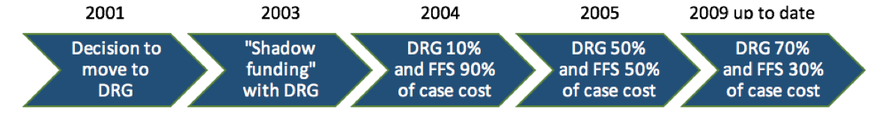
Gradual implementation
2001 – decision to implement case-mix system by EHIF was made. Preparatory work included e.g.:
    Implementation of new procedure classification
    Grouping simulation to forecast the impact of DRG implementation
2003 – DRGs were used as a grouping tool
2004 – DRGs started to use as a financing tool....
.... but, DRGs were/are used in combination with the FFS and per diem rates, i.e. only a proportion of each case is reimbursed on the basis of DRG price

Slide 33
International experiences

Slide 34
Features of DRG systems: evidence from 29 low and middle income countries
In many countries, DRG-based payments applied to both public and private sector providers
Hospitals need a certain degree of autonomy in management and spending
All countries for which information was available had a budget ceiling in place
Most of the countries used 500–800 DRG case groups (which is consistent with OECD countries)
The base rate value was ultimately a reflection of the overall amount of funding available
Most countries had adjusted cost weights in some way to their country context
The lack of standardized data generation and coding procedures had slowed down the introduction of DRGs
Source: Bull World Health Organ 2013;91:746–756A | doi: http://dx.doi.org/10.2471/BLT.12.115931

Slide 35
Implementation: Options to phase in DRG system
Phasing of the proportion of inpatient activity covered, e.g. phasing of the number of DRGs subject to case-based payment or those with long wait times
Phasing of the proportion of the average price to be paid under new, standardized arrangements, and what proportion to be paid based on a hospital’s own, historic level of funding
Phasing the nature of costs covered by case-based payments, e.g. non-salary costs might be covered but salary costs might be paid as input-based subsidies
  “Shadow funding” arrangements can also be used, whereby hospitals are advised of what they would have received if the new funding method were implemented;
Phasing of the number of participating hospitals, e.g. voluntary participation (e.g. Republic of Korea)
Phasing the proportion of patients covered by the scheme, e.g. separation by funders
Source: http://www.wpro.who.int/asia_pacific_observatory/country_comparative_studies/who_apo_drg.pdf

Slide 36
Phase in of DRGs in Germany
2000-2002
2003 - 2004
2005 - 2009
2010 - 2014
1) Phase of preparation
2) Budget-neutral phase
3) Phase of convergence
to state-wide base rates
4) Further developments
Historical Budget (2003)
Transformation
DRG-Budget
(2004)
Nationwide base rate
Dual Financing or Monistic
Introduction of DRG-like reimbursement for psychiatric hospitals
Selective or uniform negotiations
Quality Assurance (adjustments)
Hospital specific base rate
15 %
20%
20%
20%
Statewide
base rate
25%
25%
20%
20%
20%
15 %
Hospital specific base rate

Slide 37

Recommendations for DRG implementation...*
Recipe
    3 drops of DRG-efficiency elixir
    A pinch of quality-assurance powder
    consultations quantum satis
    training ad nauseam
Misce cum consensus socialis
Da in solutionis infotechnologicus
Signa: Per usum ad curatio homines
Source: Presentation by Toomas Palu in "Health Care Forum 2001” in Estonia

Slide 38

Questions?

